Slide 1
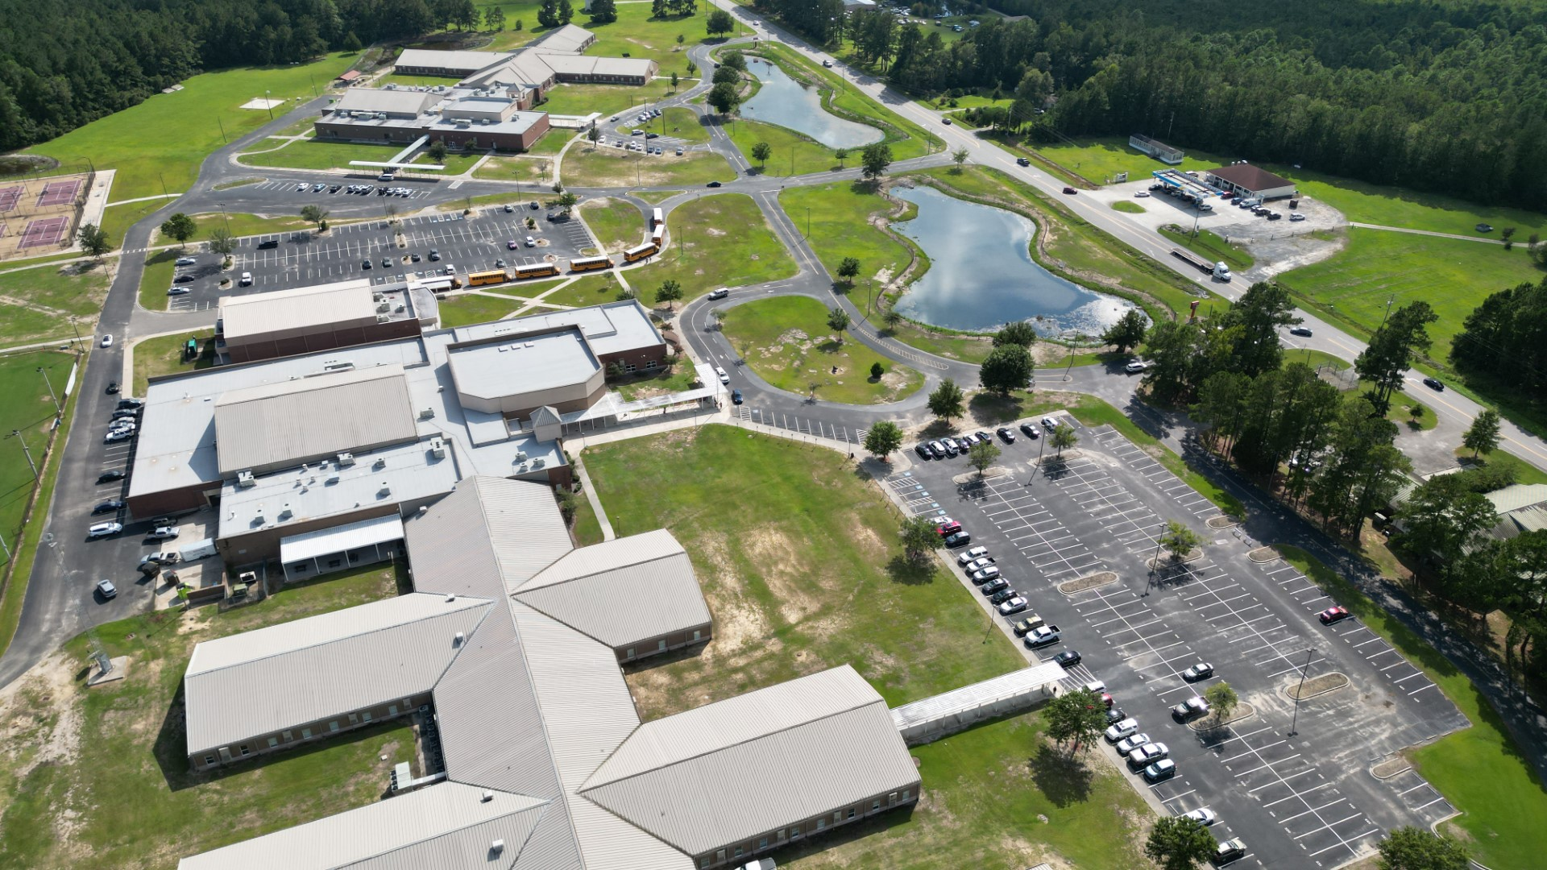
Spectator Parking
Bus & Spectator
Parking Overflow

Slide 2
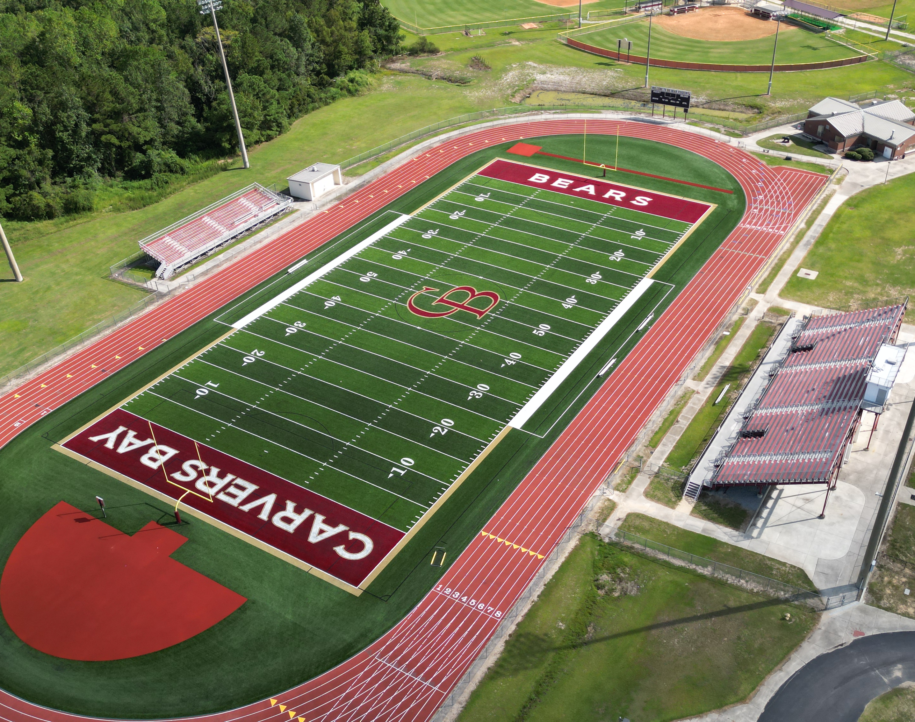
Teams will be allowed to set up in the following designated areas:
On the left side of the HOME side bleachers (when standing in front)
Top of the bleachers on the HOME side but not in front of the press box.
On the VISITORS side: in the bleachers and along the fence.
Team Setup
Clerking Tent
Team Setup
Team Setup
Warmup area
Team Setup

Slide 3
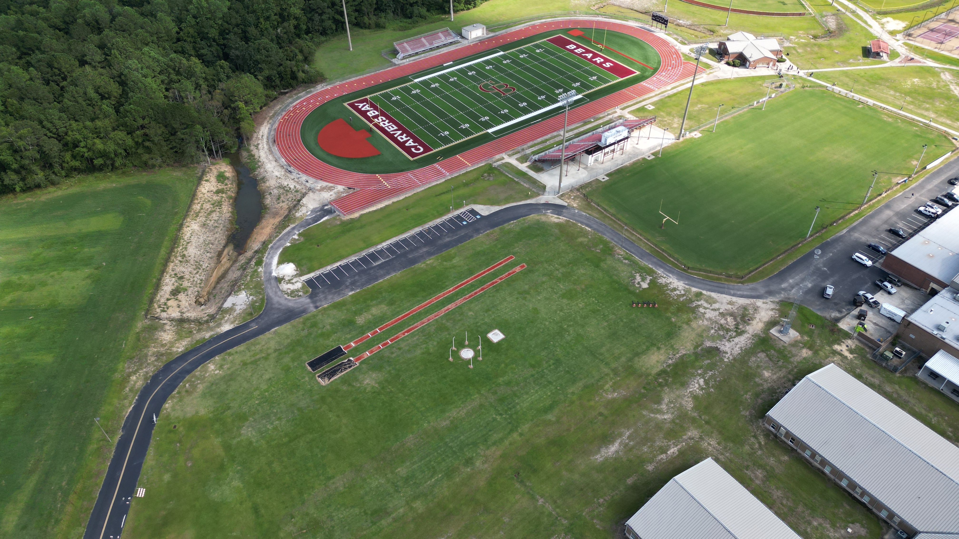
Pole Vault
Ticketing/Access to Track
High Jump
Access toTrack
Javelin
Coaches Box
Coaches Box
Shot Put
Discus
Long &
Triple Jump
Coaches Box

