Slide 1
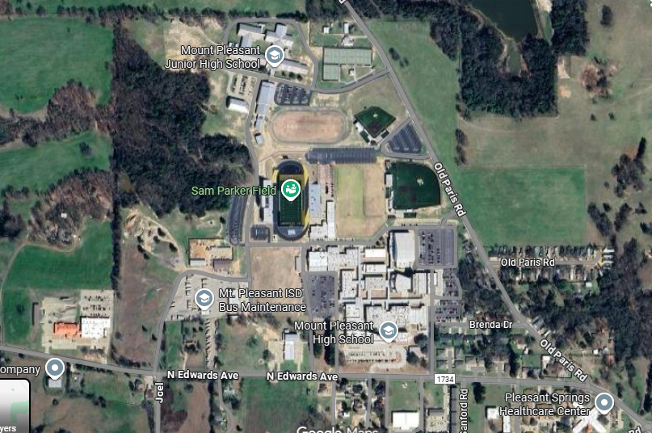
Overflow parking only
Overflow parking only
No Parking
Team camps
No Parking
Hospitality and check in
Bus Drop off
Volunteer parking only
XC Bus parking
V-ball parking only
Handicap Only
V-ball and Bus parking
XC Parent parking
V-ball
entrance
v-ball
XC entrance
XC

